Slide 1
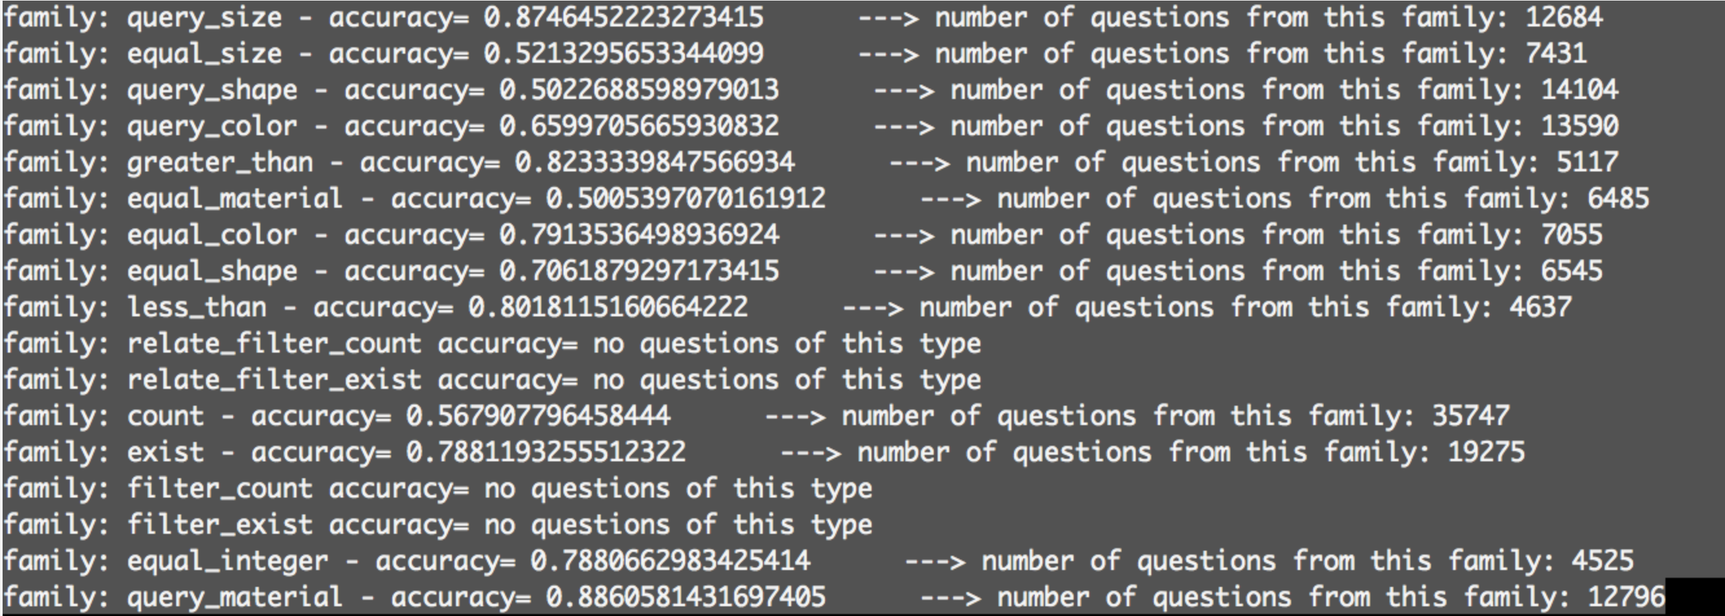
CLEVR CogenT

Slide 2
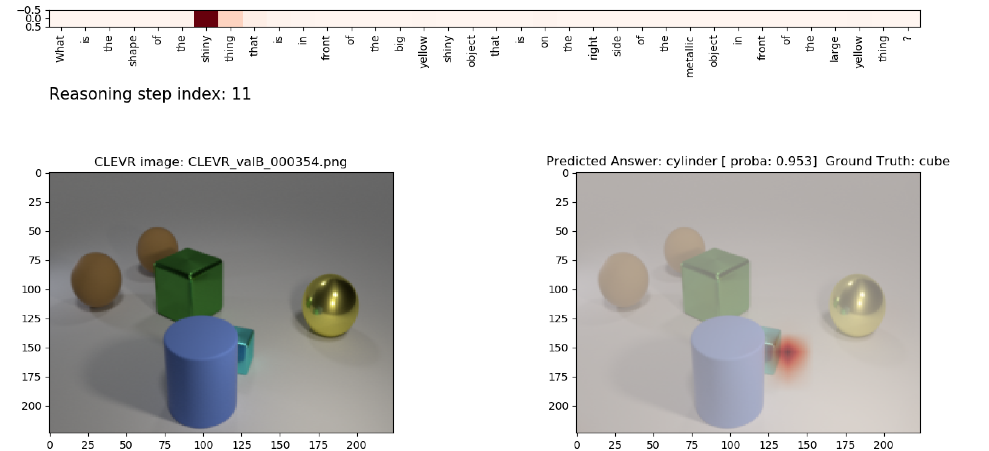
CLEVR – CogenT
Query_shape

Slide 3
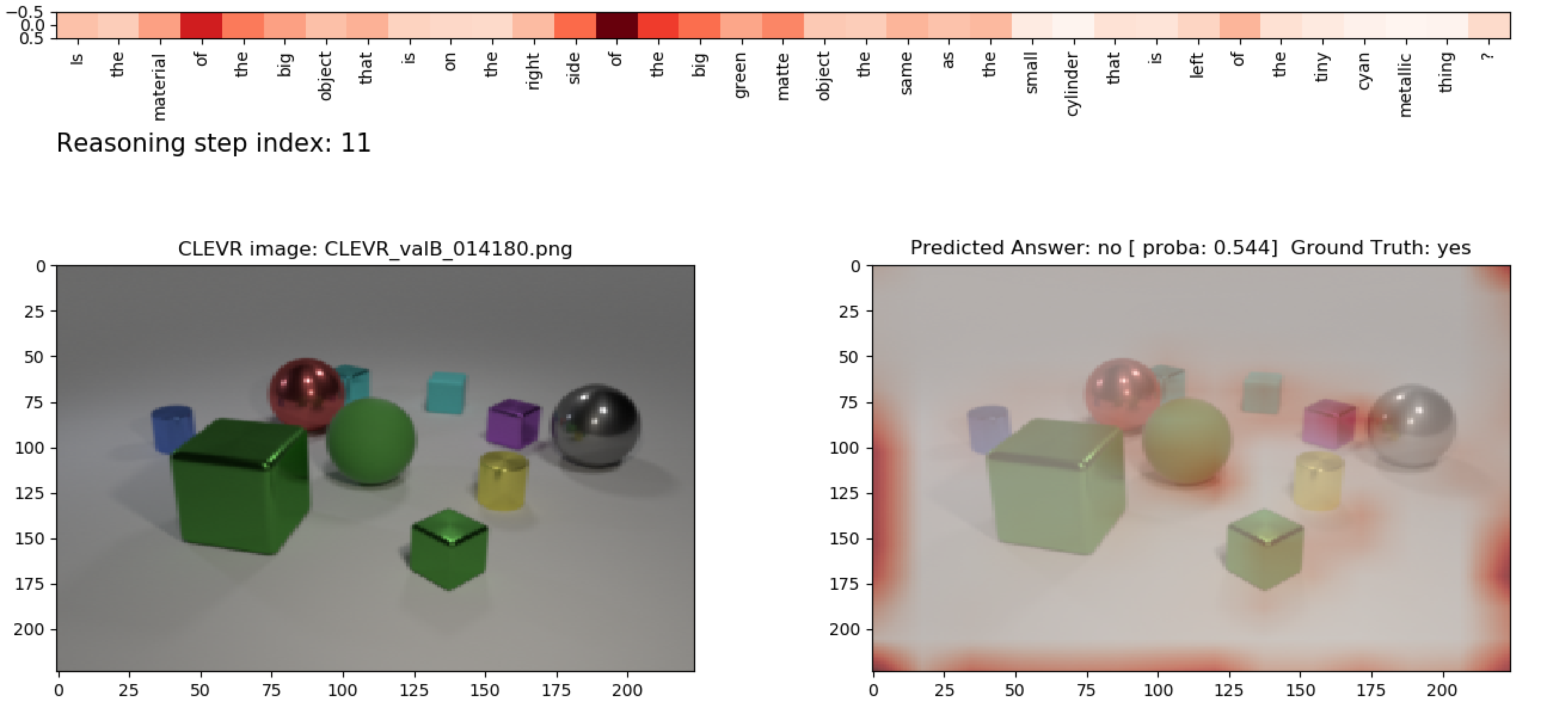
Equal_material

Slide 4
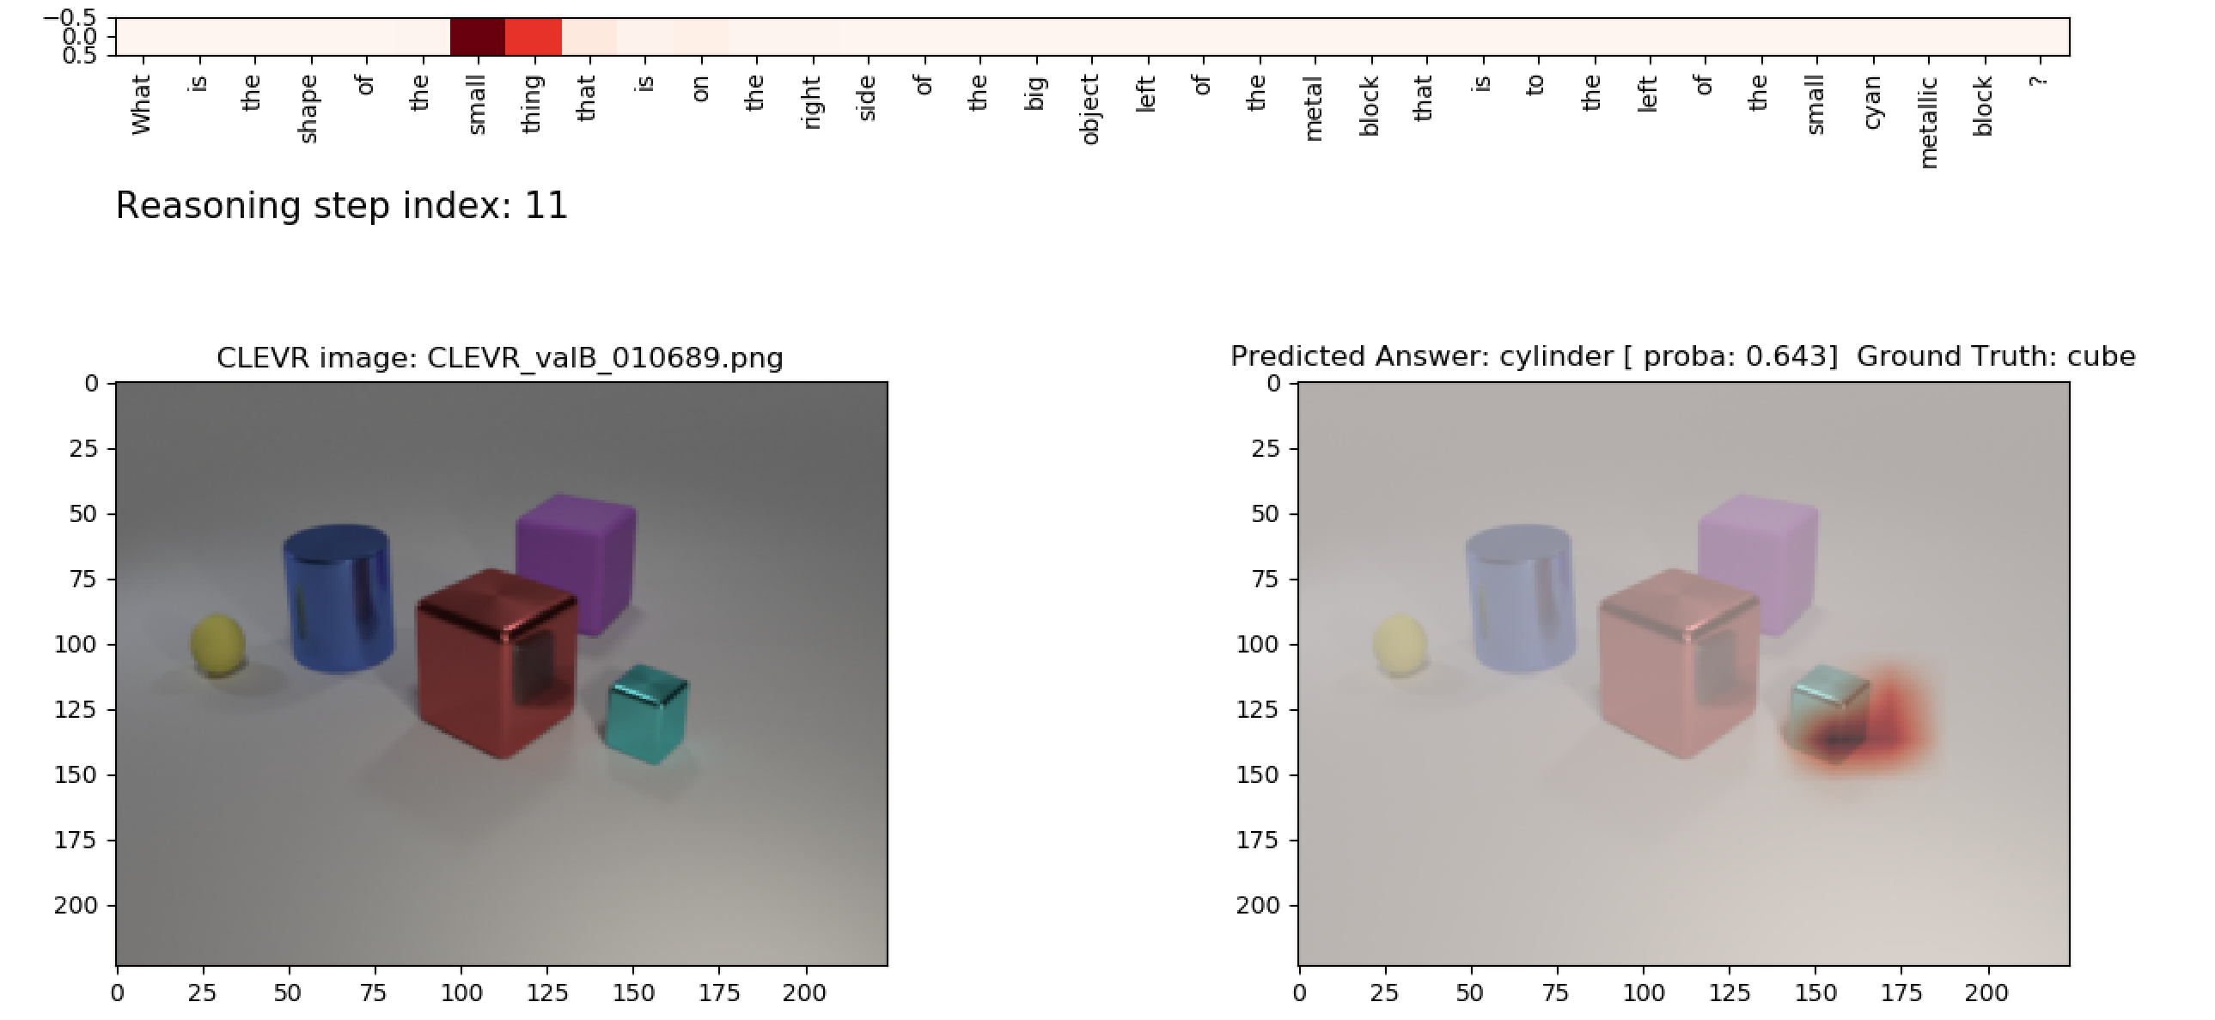
Query_shape

Slide 5
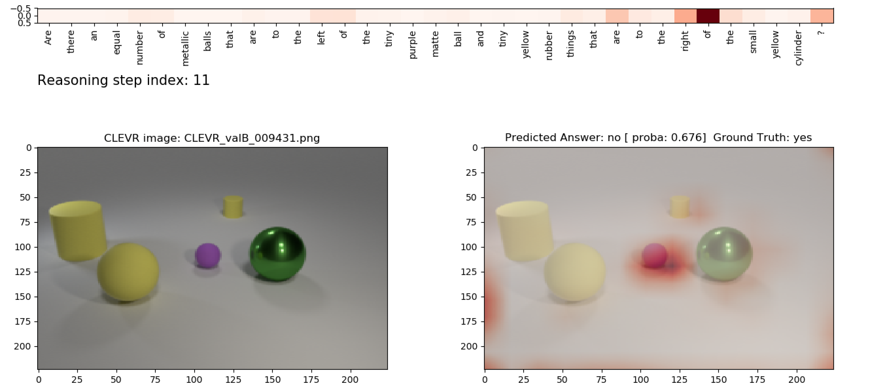
Equal_integer

Slide 6
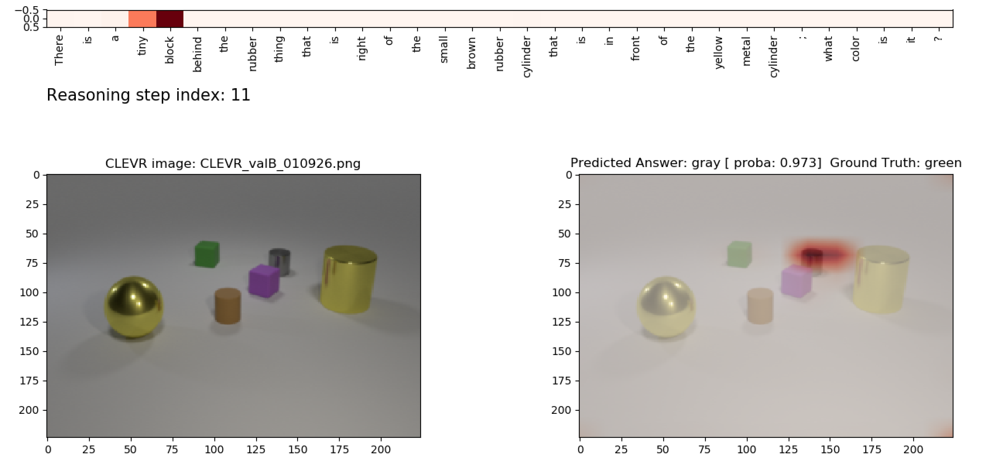
Query_color

Slide 7
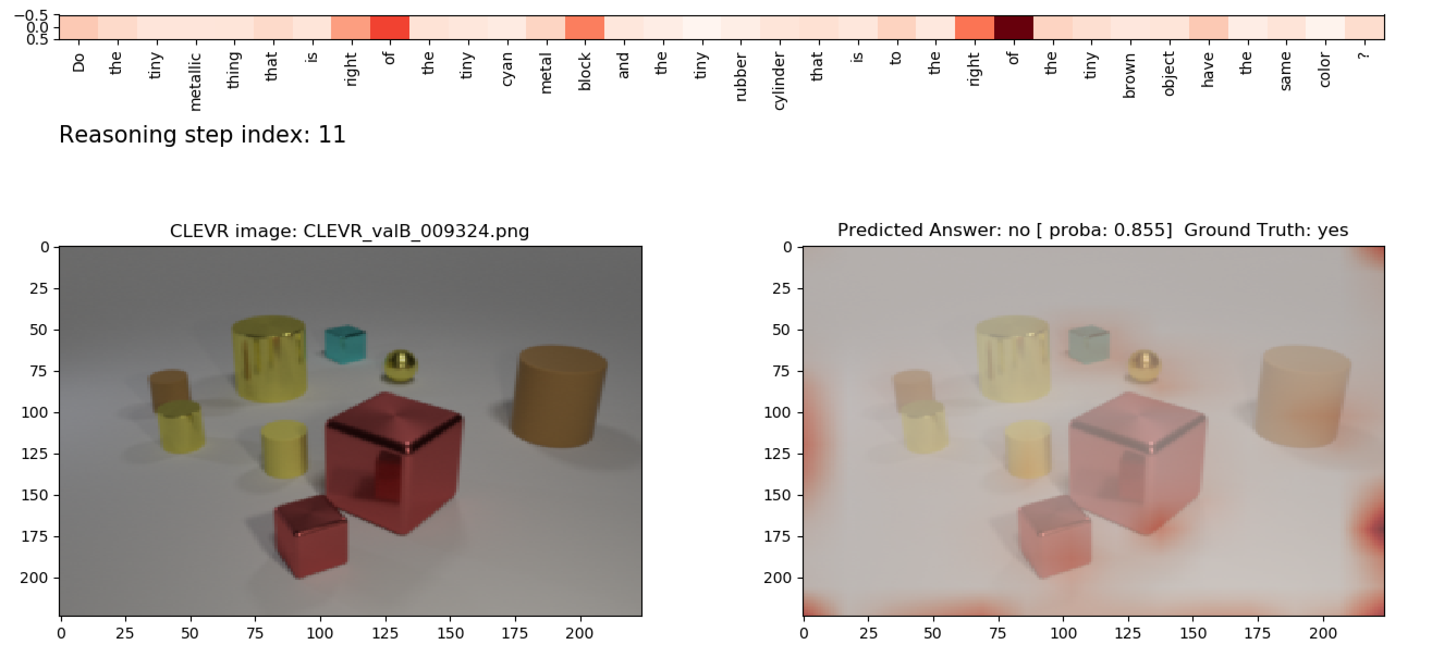
Equal_color

Slide 8
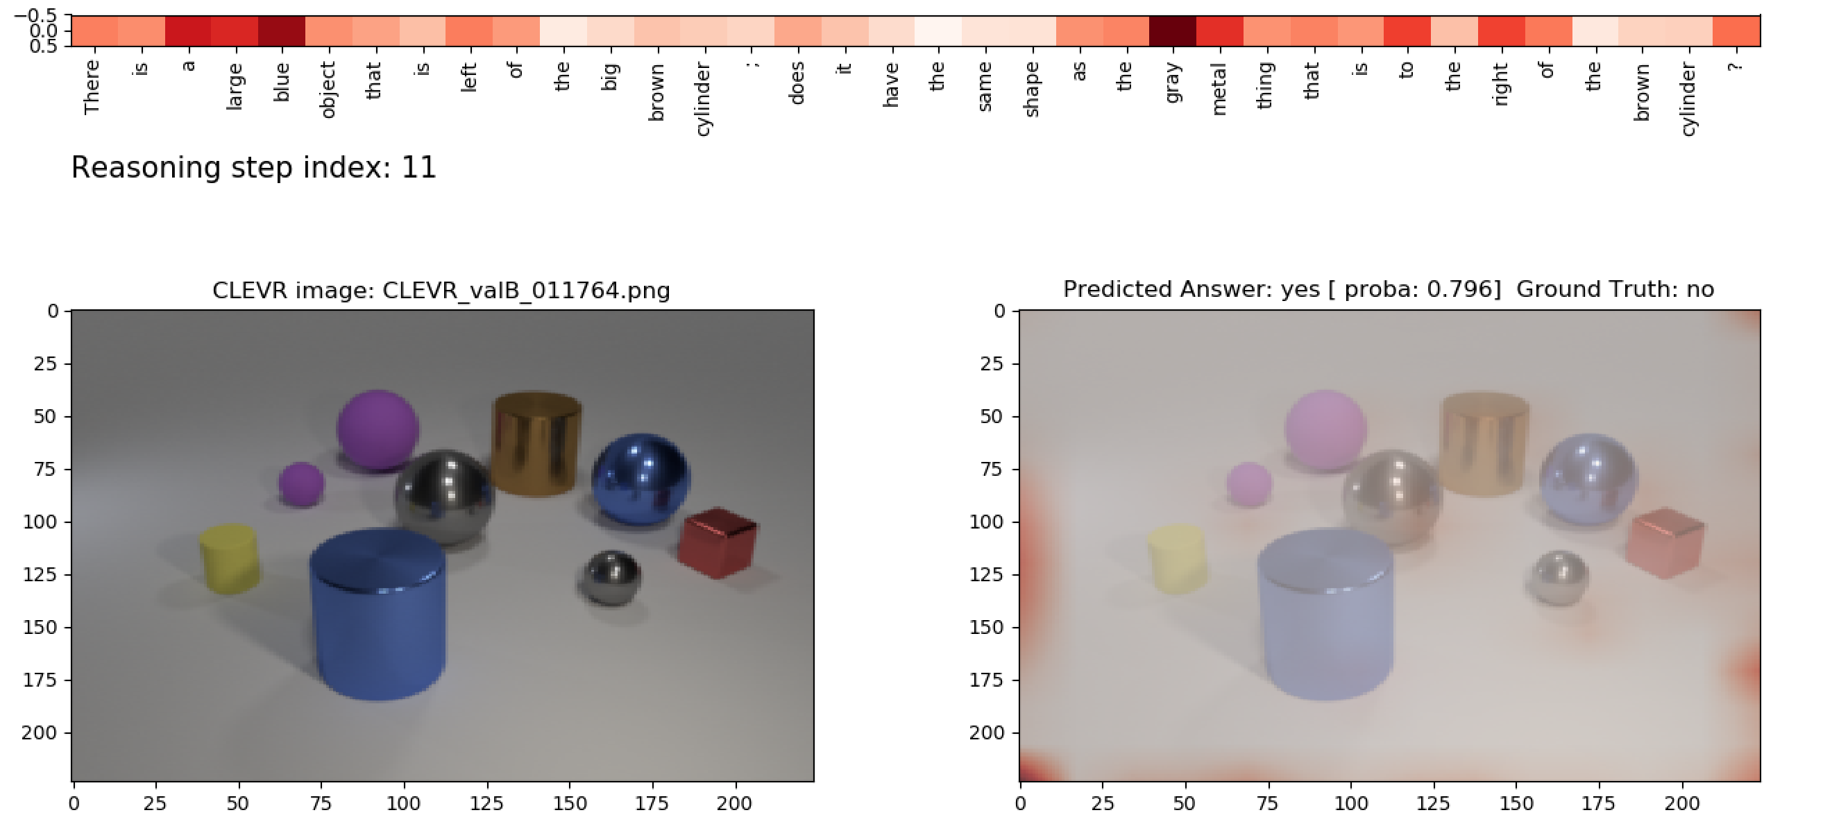
Equal_shape

Slide 9
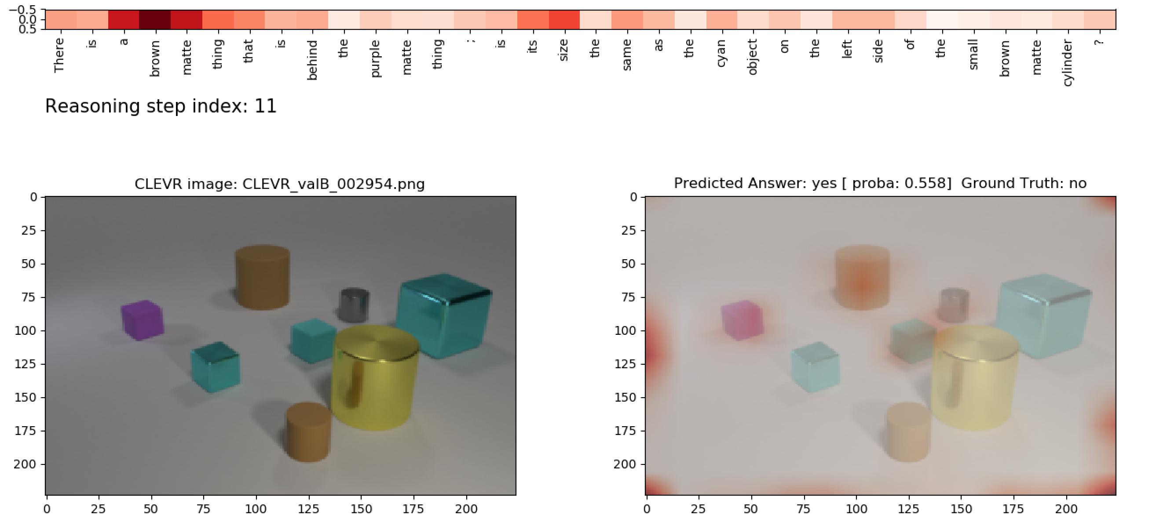
Equal_size

Slide 10
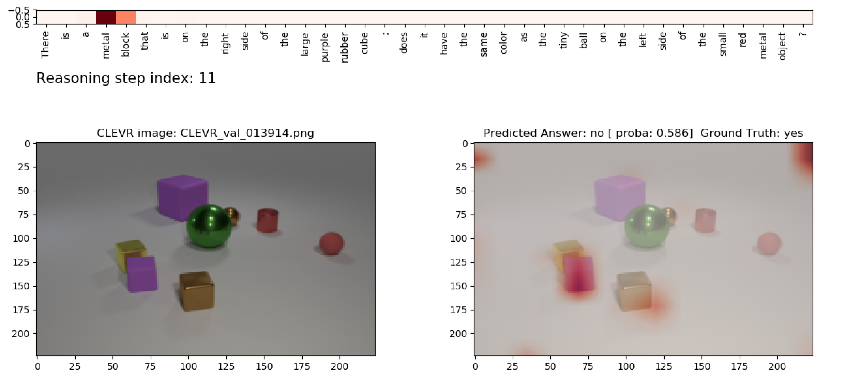
Equal_material

Slide 11
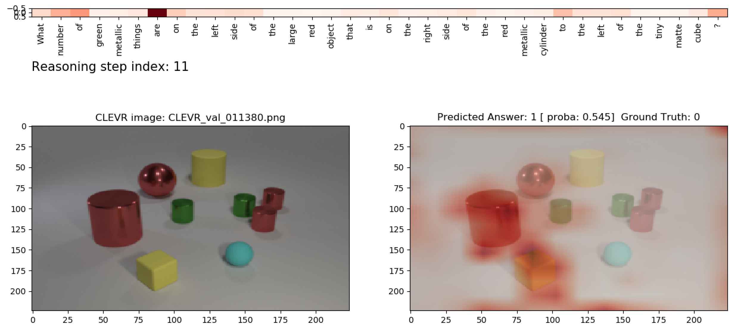
Count

Slide 12
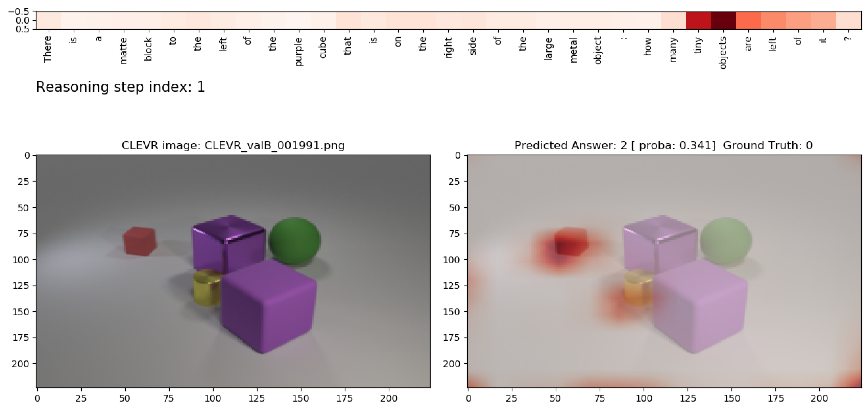
Counting

Slide 13
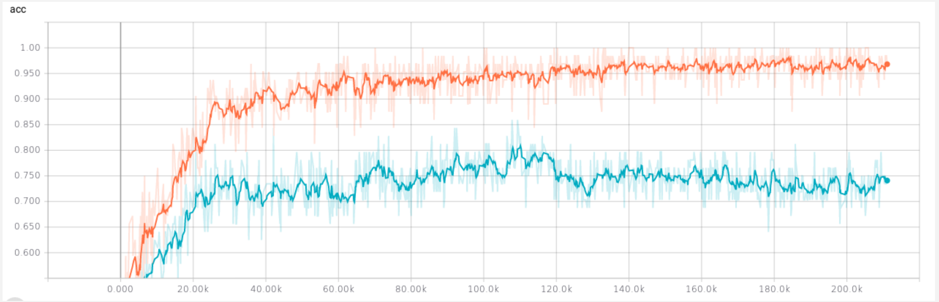
CogenT - Train on A - Val on B

Slide 14
Few Ideas
Simple ideas
mi=ri
LSTM cell on mi -> pass the last hidden state to the output unit
Improve image preprocessing ( bounding boxes –> mykias)
Add more learnable CNN layers after RESNET pretrained layers
Reasoning Steps= 8 and less - make it a learnable parameter would be ideal
Weird ideas:
Feed back mi as an input of the input unit

